Slide 1
US 70 Multimodal Corridor Plan
Hillsborough

Slide 2
Outline
Background
Existing Conditions
Public Engagement
Draft Plan
Goals, Objectives, Critical Issues
Recommendations
Implementation
Funding

Slide 3
Background

Slide 4
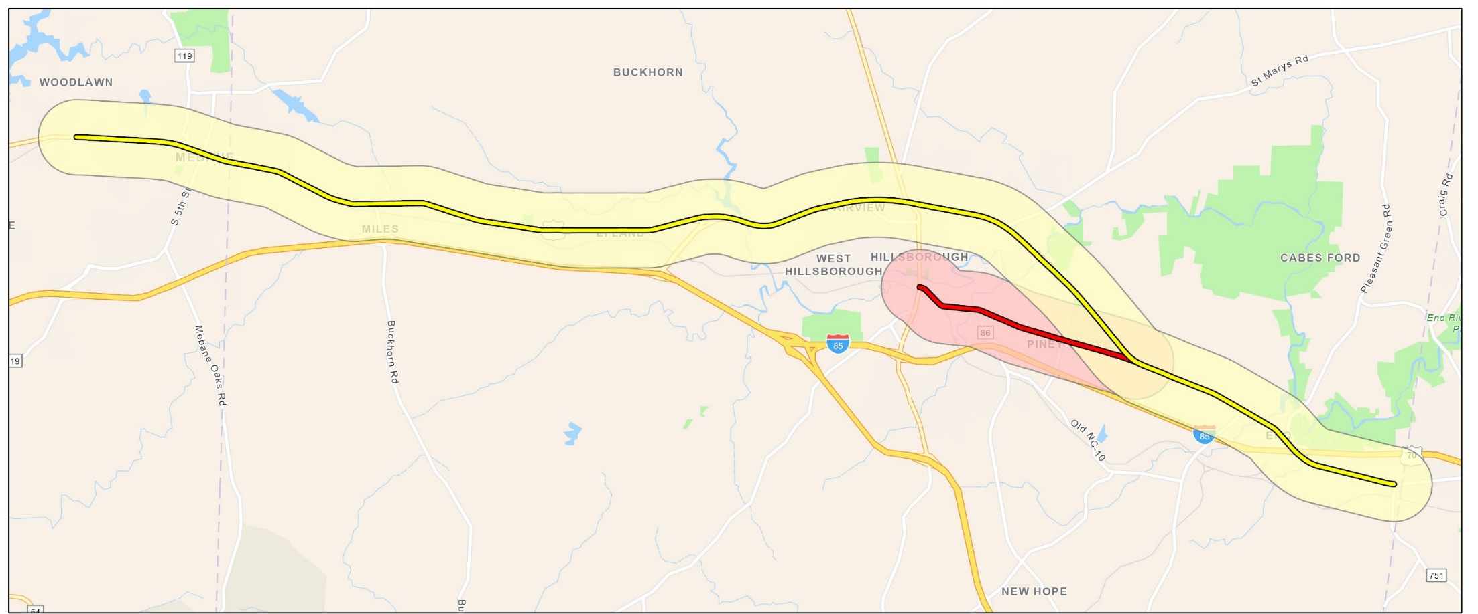
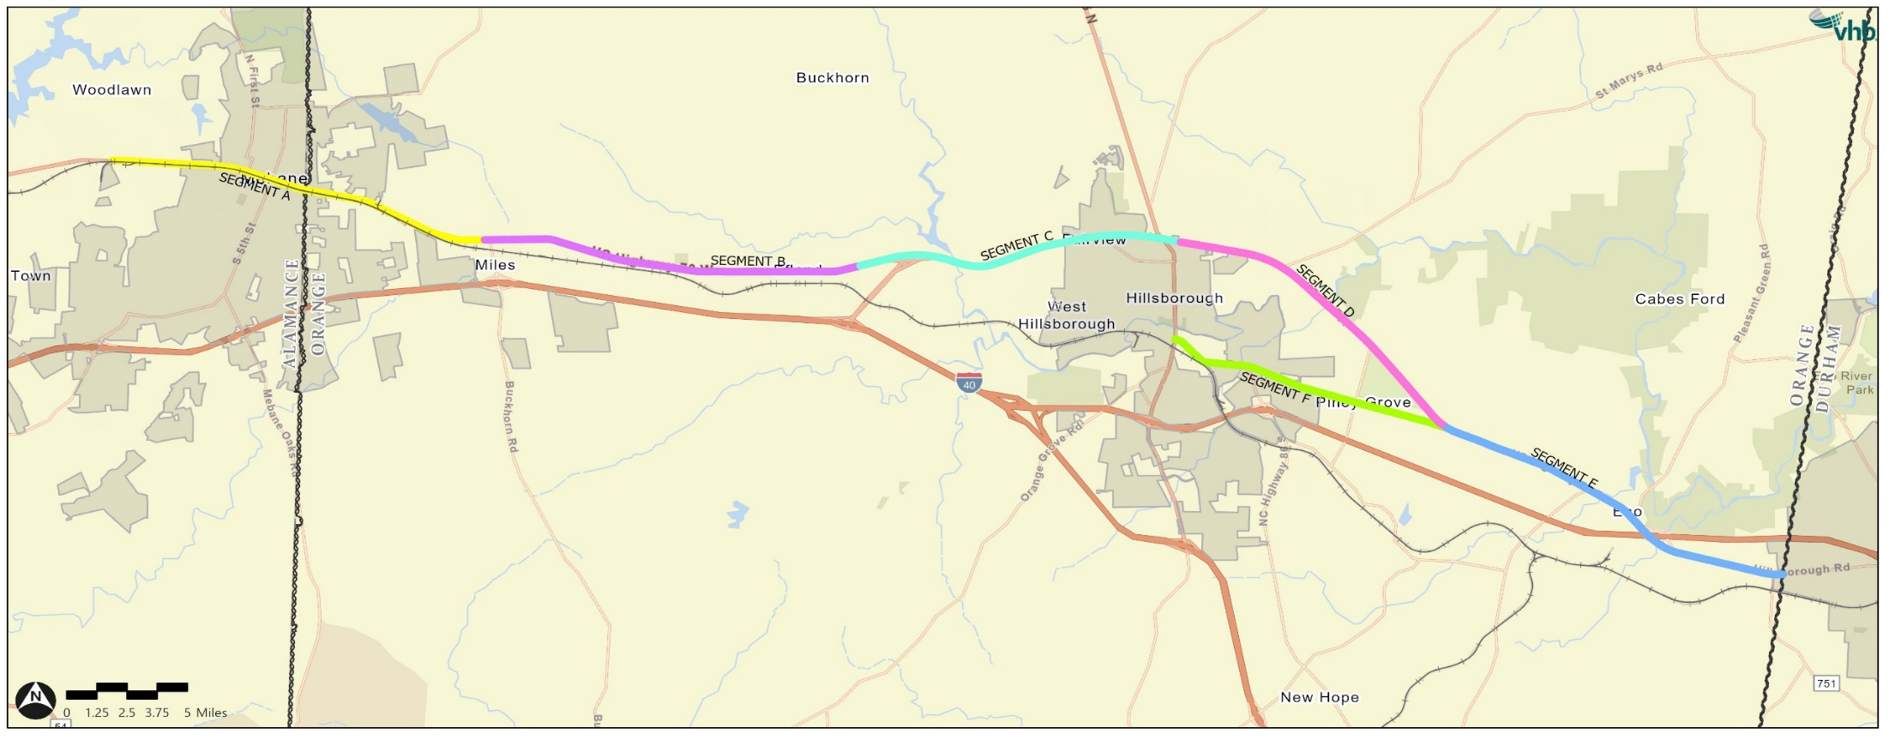
Study Area
Includes 70A in Hillsborough
6 Segments
Studies separately & collectively

Slide 5
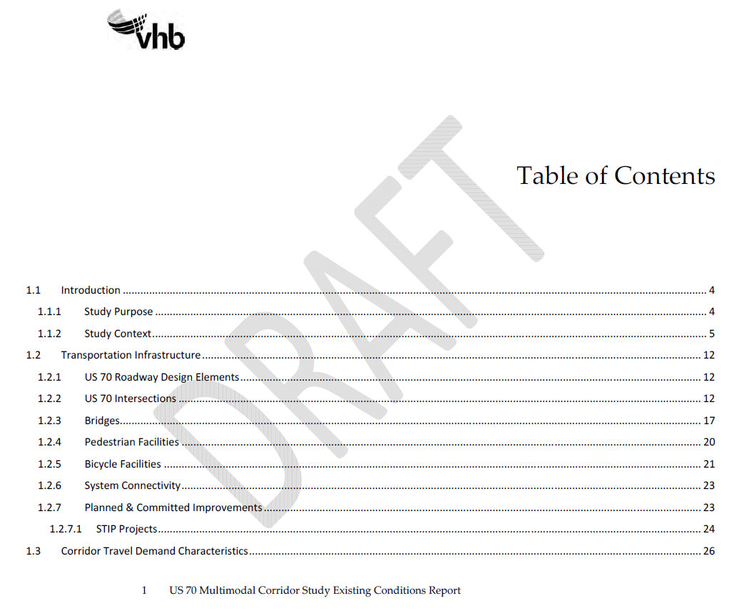
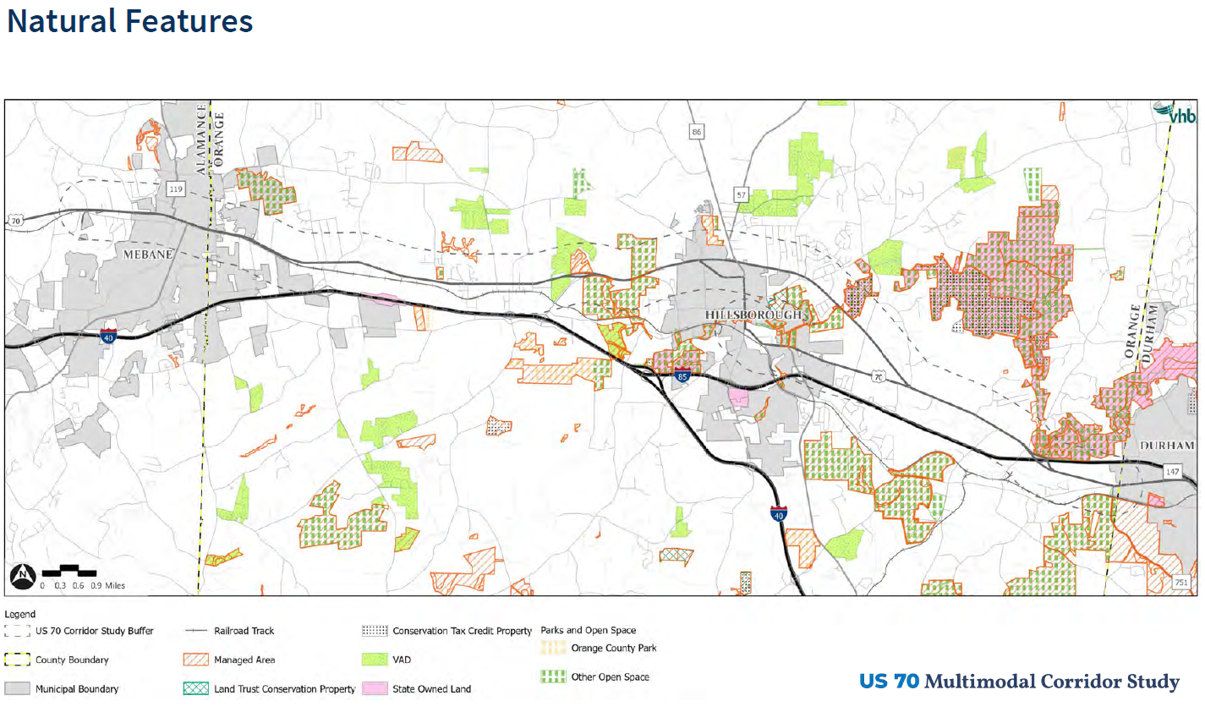
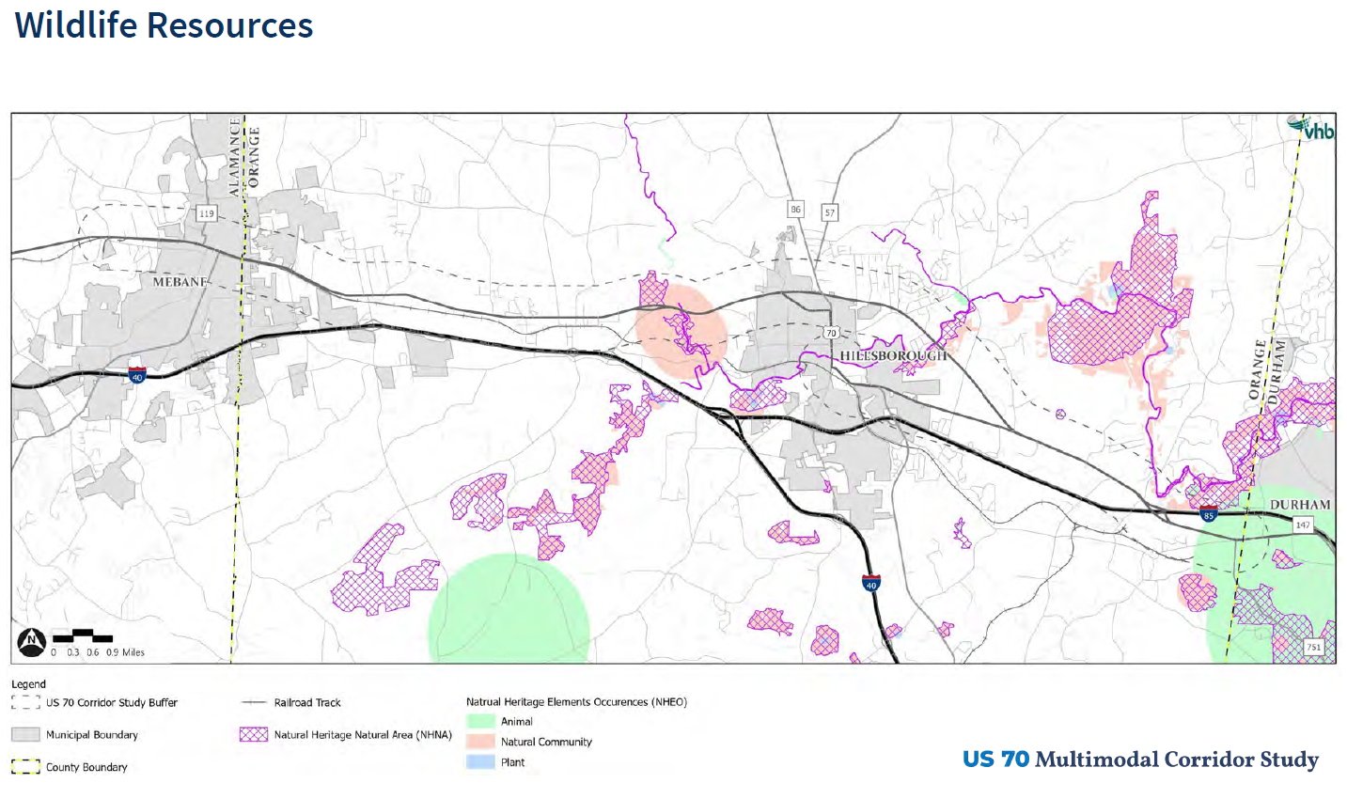
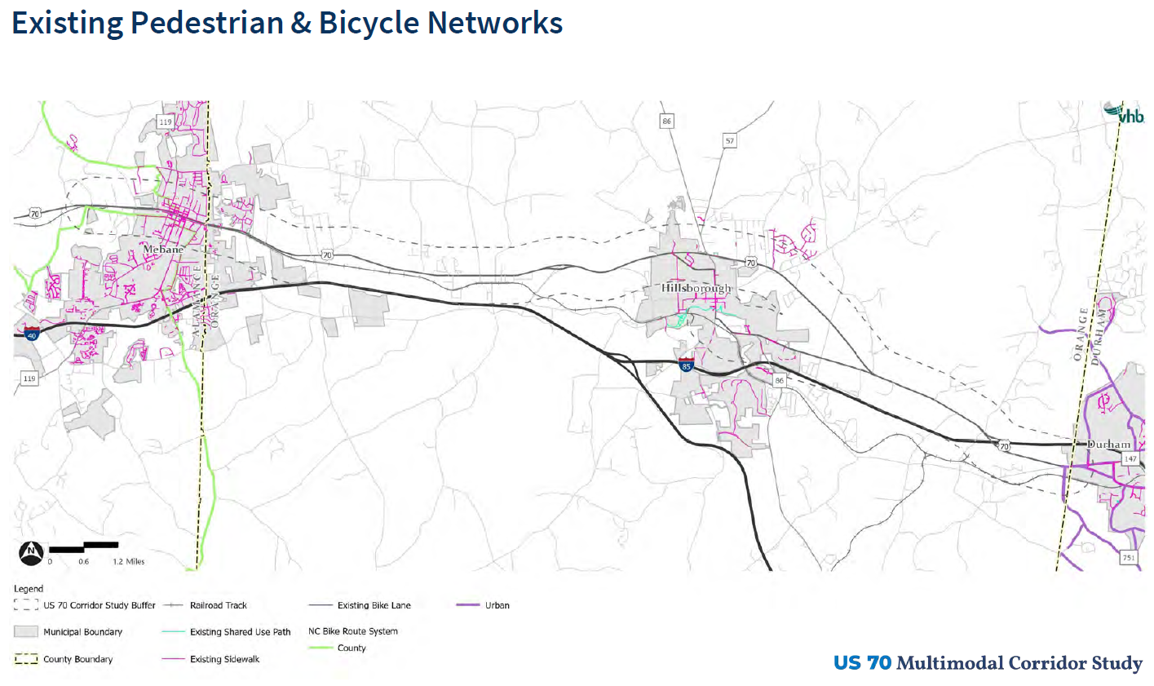
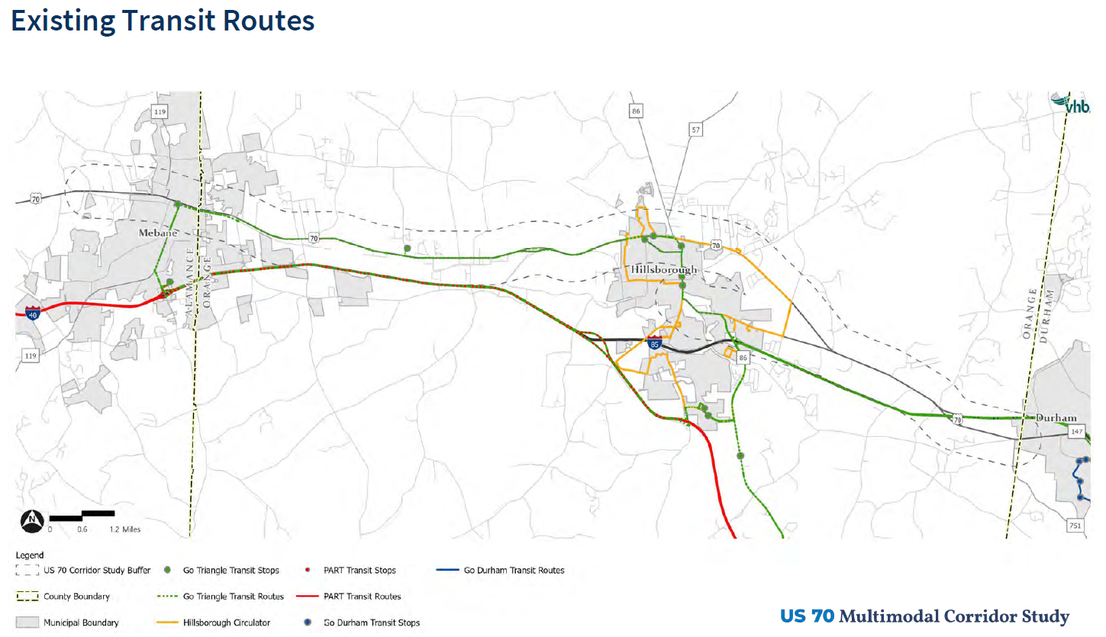
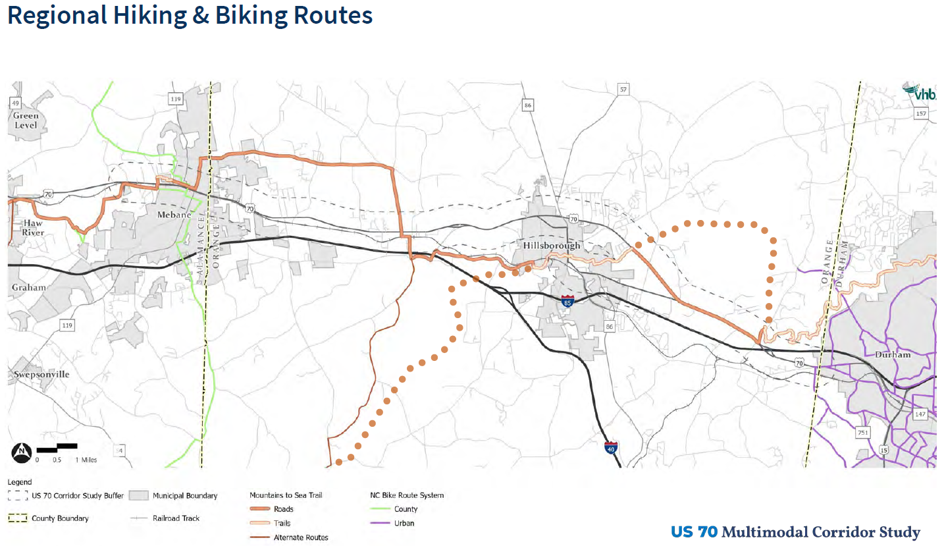
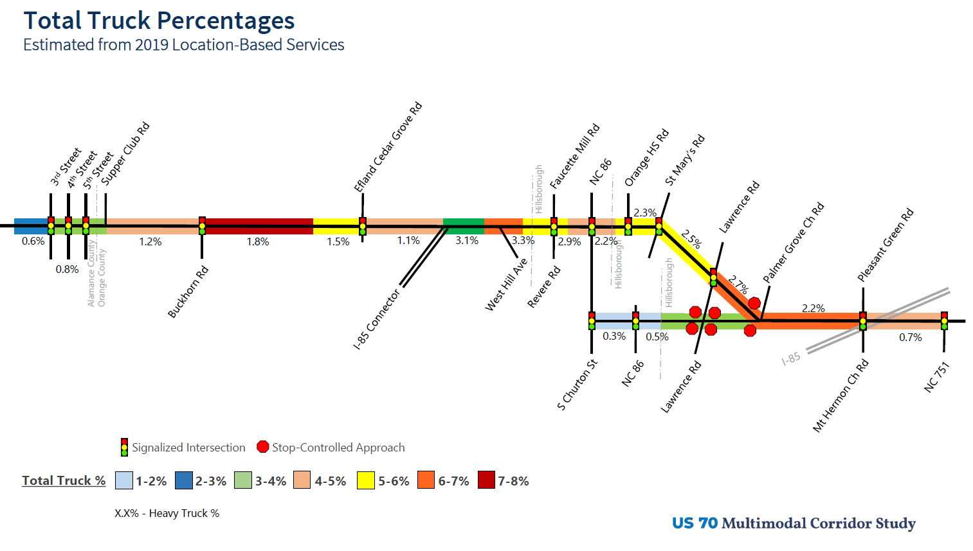
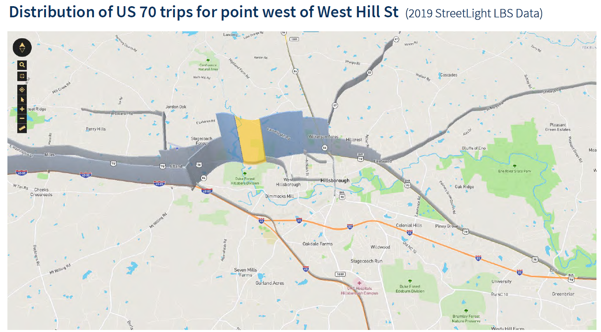
Existing Conditions
Including:
Traffic Volume
Level of Service
Heavy Truck
Peak & non-Peak
Off-road crashes

Slide 6
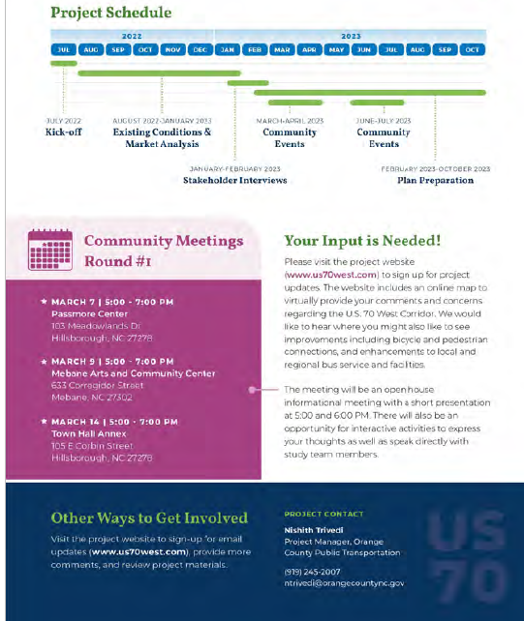
Public Engagement
1st Round Workshop
March
2nd Round Workshop
November/December

Slide 7
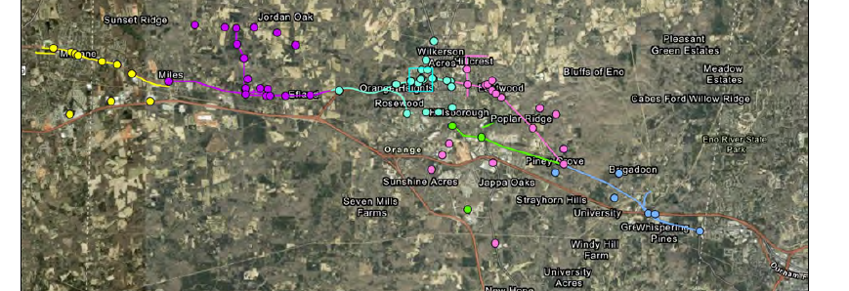
Public Engagement
Relieving vehicular congestion
Slowing down speeds of cars
Improving intersections and crosswalks
Maintain the character of the corridor
Providing more bus, pedestrian and bicycle connections
Improved access and circulation into schools.

Slide 8
Goals and Objectives
Manage traffic congest
Prioritize bike/ped.
Improve transit access
Mobility
Transportation investment protect community character
Prioritize bike, ped, and transit in urban areas
Placemaking
Improve comfort for non-automobile users
Work towards Vision Zero
Reduce pedestrian-automobile conflicts
Safety
Job Access
Improve access to jobs in and outside corridor
Natural Environment
Improve multimodal access to parks
Reduce wildlife-automobile conflicts

Slide 9
Critical Issues
Natural Environment
Natural areas that are recreational destinations lack connectivity to the multimodal transportation network
The corridor experiences a large amount of animal crash incidents.
Built Environment
US 70 poses a significant barrier to pedestrian connectivity in urban areas despite existing crossings.
US 70 does not have sufficient multimodal facilities to support its growing business.
US 70 detracts from the character of the municipalities it traverses.

Slide 10
Critical Issues
Active and Vehicular Transportation
Low-income populations have limited access to the multimodal transportation network.
Inadequate pedestrian connectivity to bus stops reduces transit demand.
Existing pedestrian facilities do not serve most of the corridor.
No dedicated bicycle facilities exist in the corridor.
Schools in the corridor are significant sources of congestion.
Roadway infrastructure in the corridor does not have the capacity for the future projected traffic demand
High traffic speeds contradict existing and planned residential and commercial development in the corridor.

Slide 11
Critical Issues
Transit
Low-income populations have limited access to the multimodal transportation network.
Inadequate pedestrian connectivity to bus stops reduces transit demand.
No bus stop in the corridor meets ADA standards.
Areas projected to experience significant employment growth, particularly for low-income jobs, are not served by public transit.
Bus service is too infrequent to be a convenient, reliable travel option, especially for those commuting at non-traditional times.
Bus routes do not serve some of the corridor’s largest trip producers and attractions.

Slide 12
Critical Issues
Safety
Pedestrian crossings across US 70 lack adequate safety features.
High traffic speeds pose a significant threat to non-automobile users.
No dedicated bicycle facilities exist in the corridor.
The corridor experiences a large amount of animal crash incidents

Slide 13
Recommendations - Policy
Extend sidewalk connectivity to anticipated growth areas.
Establish a maintenance agreement between NCDOT and Orange County for new and existing pedestrian facilities on US 70.
Require developers building on land parcels fronting US 70 to either construct sidewalk along their frontages, dedicate ROW for future construction, or pay in lieu.
Manage travel demand for future development in the Efland-Buckhorn-Mebane economic development area.
Update the Efland-Buckhorn-Mebane Access Management Plan to include pedestrian, bicycle, and transit connectivity recommendations.

Slide 14
Recommendations - Hillsborough
Reduce Speed Preferably 35 mph
Intersection Improvements
Transit Oriented Development

Slide 15
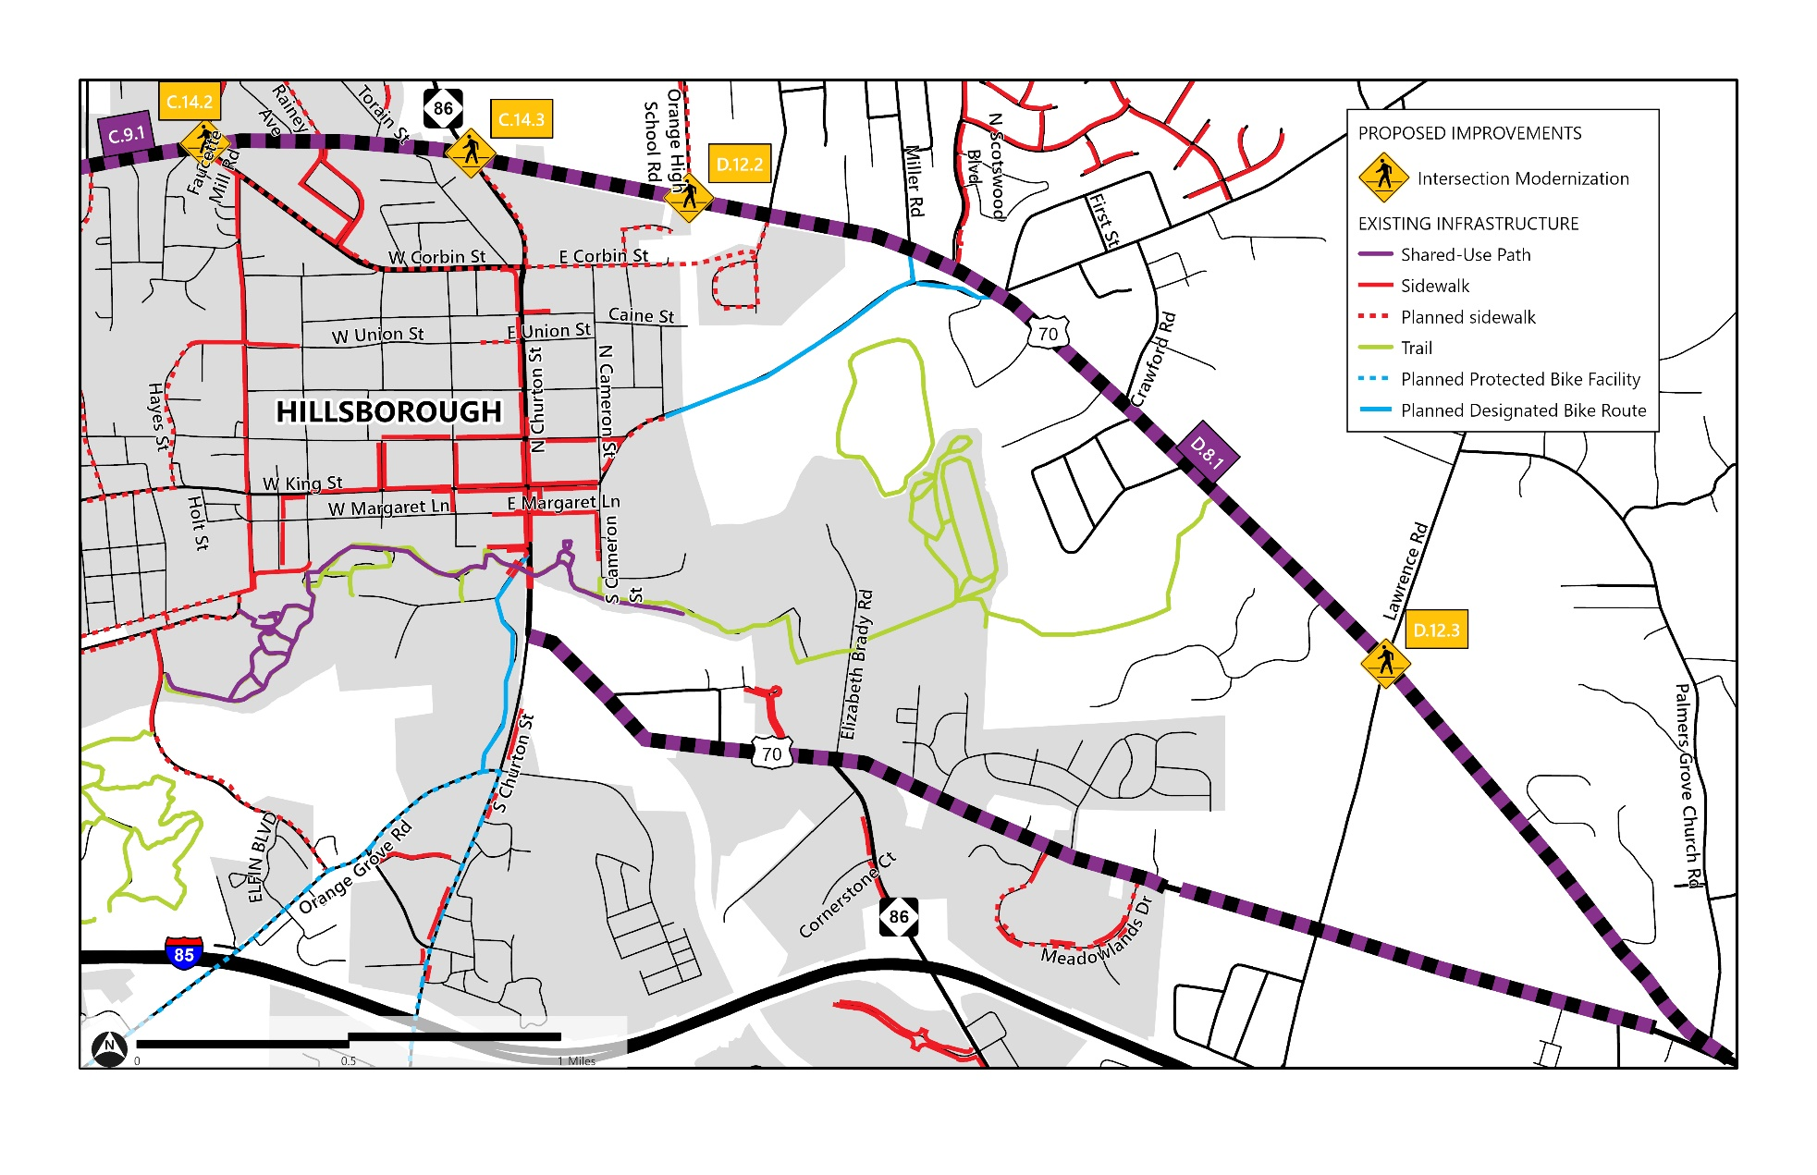
Recommendations - Hillsborough

Slide 16
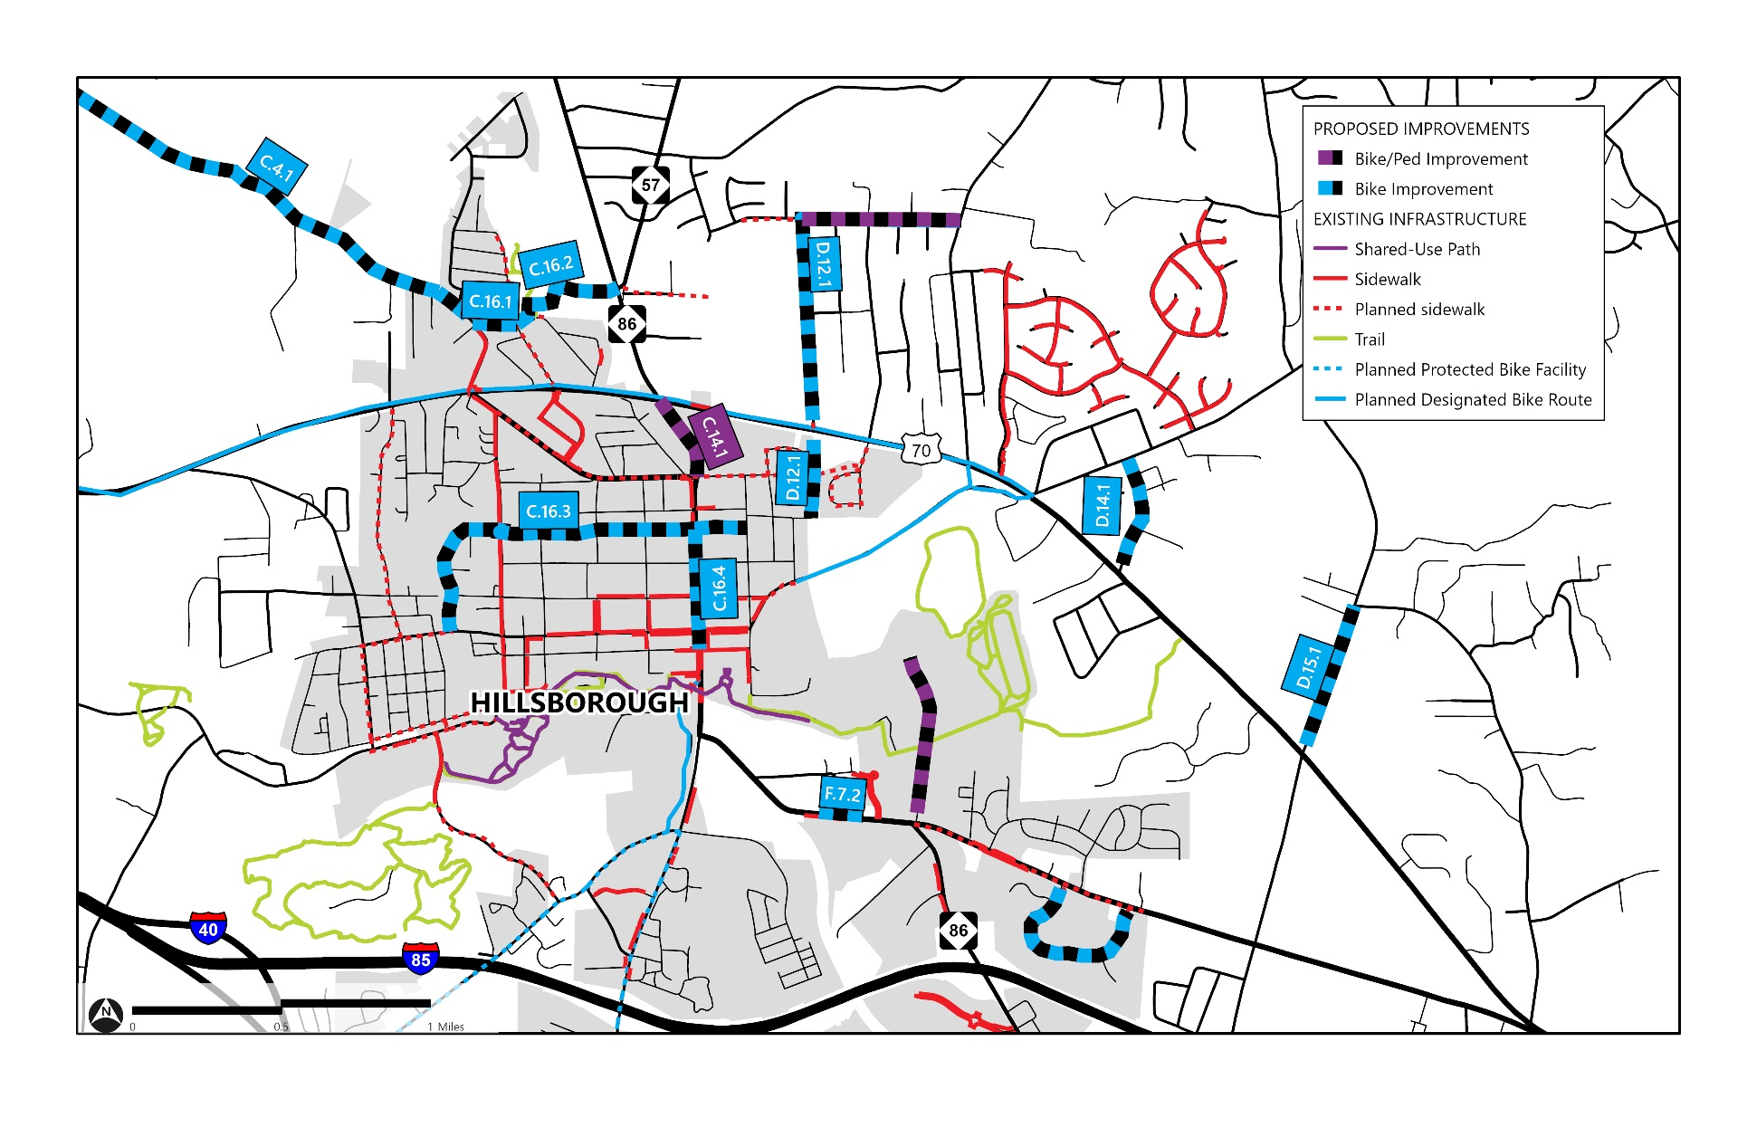
Recommendations - Hillsborough

Slide 17
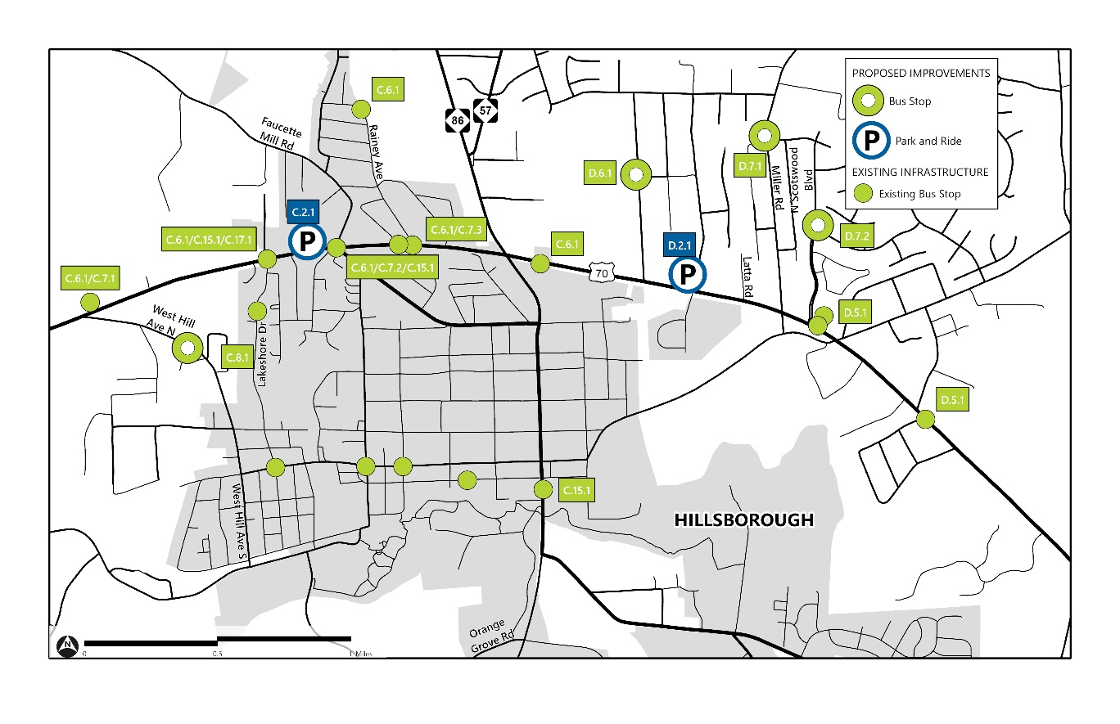
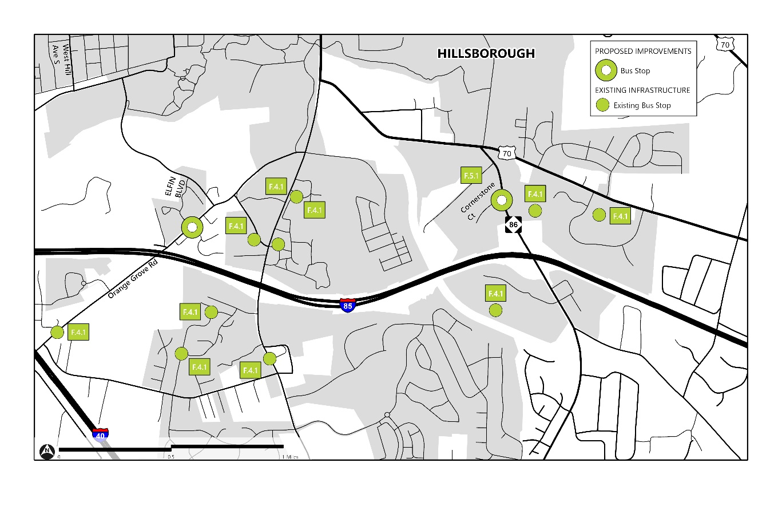
Recommendations - Hillsborough

Slide 18
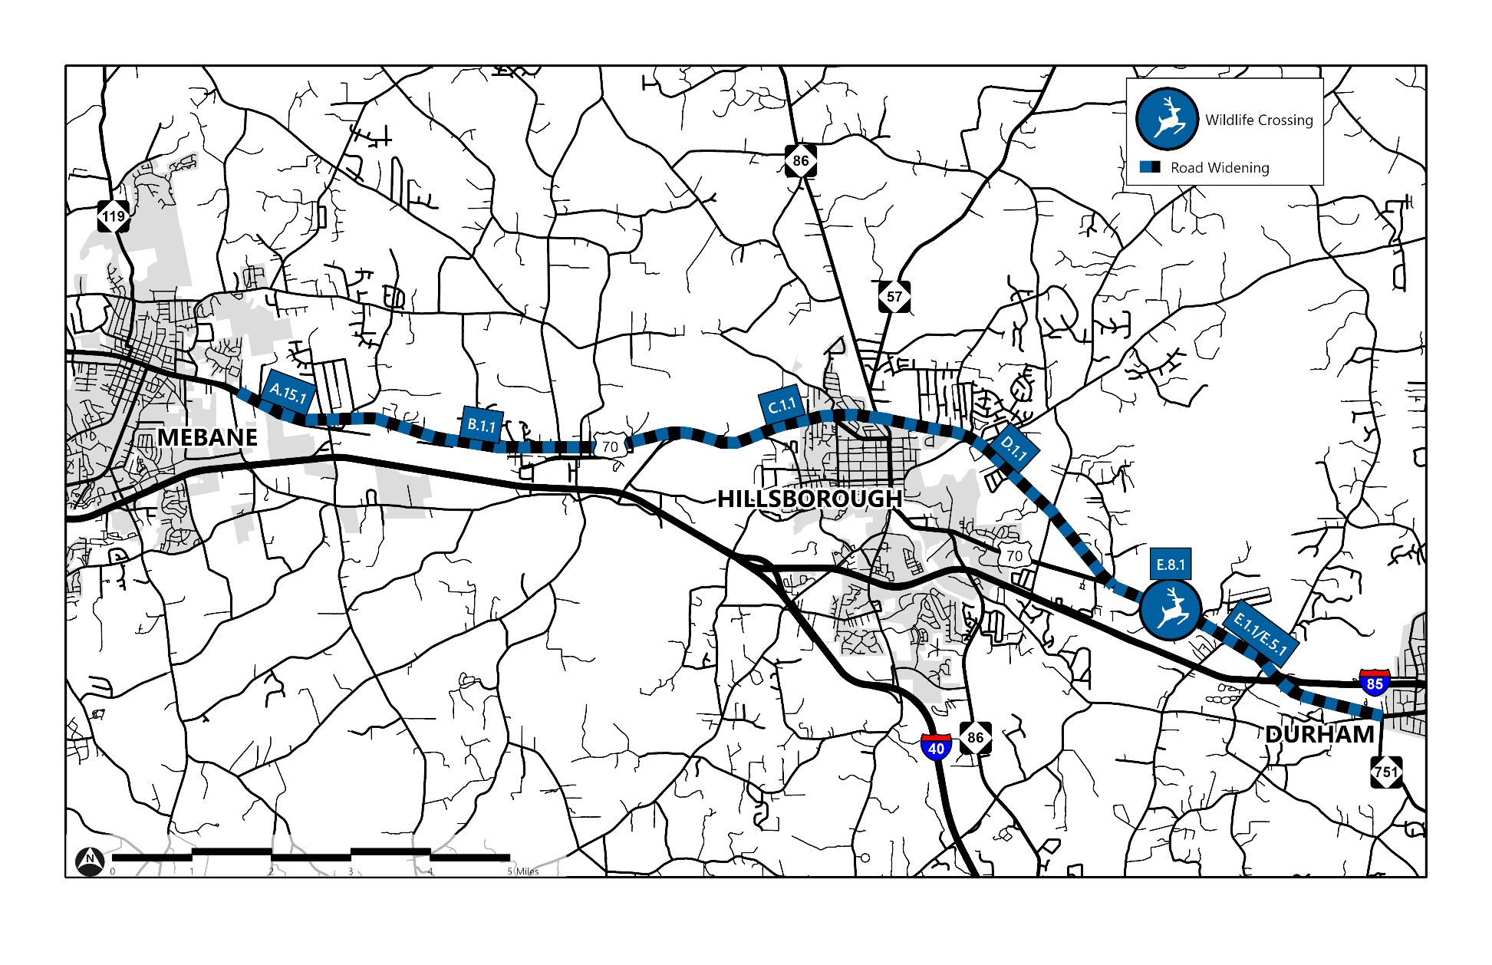
Recommendations - Hillsborough

Slide 19
Recommendations - Funding
Federal
Rebuilding American Infrastructure with Sustainability and Equity (RAISE)
Safe Streets For All (SS4A)
TPM Bus and Bus Facility Grant Program (TPM)
State
Transportation Improvement Program (STIP)
Complete Streets
SPOT Safety/Mobility/HSIP
Local
Private Development
Local Government

Slide 20
Requested Action
Approve US 70 Multimodal Corridor for portions of Segment C, D and F without Hillsborough Town Limits
Endorse US 70 Multimodal Corridor outside Hillsborough.

