Slide 1
Potential for Urban Archery Program in Hillsborough
Board of Commissioners
March 11, 2024

Slide 2
Introduction
In January, a group of residents approached the Board regarding their interest in starting an Urban Archery season in Hillsborough to address deer overpopulation
The residents provided a significant amount of research and background information, which can be viewed at https://mccmeetingspublic.blob.core.usgovcloudapi.net/hillsbronc-meet-398eadc7b22148ea9ba9f54b4588285b/ITEM-Attachment-001-673ee358ba5a4f14828af24ce4a5300e.pdf
An internal staff working group (Public Space & Sustainability, Stormwater & Environmental Services, Planning & Economic Development, Hillsborough Police Department) met to discuss potential regulations and questions/concerns

Slide 3
Objectives of Discussion
Recognize the issues associated with deer overpopulation
Discuss what additional tools the town can consider to address the issues

Slide 4
Additional Research
Residents interviewed the district biologist with NC Wildlife and provided the following additional information
Urban Archery program is over 20 years old
Over 60 participating municipalities
Only requirement from town is letter requesting to participate and map of eligible areas
Wildlife will enforce normal hunting regulations and will be available to assist the town with overall wildlife management plans
The town can institute additional rules beyond statewide hunting rules – time and location limits, limit on hunting weapons, additional proficiency test, etc.

Slide 5
Additional Research (continued)
Residents interviewed the district biologist with NC Wildlife and provided the following additional information
2024 season underway – about 40 deer harvested statewide, only 1 in District 5 as of late January.
District 5 includes Rockingham, Guilford, Randolph, Chatham, Lee, Alamance, Caswell, Person, Granville, Durham and Orange Counties
Deer population in Orange County estimated at 50+ per square mile – Hillsborough area estimated 41-50 per square mile
Hunting accidents in NC are rare and most injuries are due to falls from deer stands.
Feeding deer can actually cause starvation – their gut biomes don’t adjust to human-provided food

Slide 6
Additional Research (continued)
Residents interviewed the district biologist with NC Wildlife and provided the following additional information
Q: Are there any municipalities we could talk to that seem to manage a highly effective program?
A: Short answer-- No. As previously stated, many municipalities feel the need to do something. Whether it is effective for them or not. They seem to feel the need to say they are trying to address the problem. This is one way to show their citizens they are trying. Additionally, hunters do not seem particularly interested in this program for 2 primary reasons: 1) they spent the last 3 months hunting and most have filled their quotas, and 2) many do not seem to be interested in urban hunting. It does not seem to fit their understanding of what "hunting" is or entails.

Slide 7
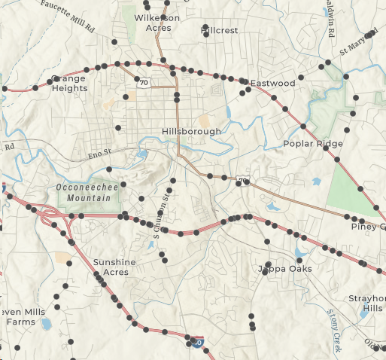
Defining the Problem
Vehicle Crash Information (NCDOT data)
2015-2022 there were 2,073 deer-related traffic accidents in Orange County (Avg. 260/yr) – ranked 30 out of 100 counties
2020-2022 data – 801 crashes, 48 injuries, $2.56m in damage
HPD feedback – not many crashes “in town”, most low speed/low impact

Slide 8
Defining the Problem
Health and Safety Concerns
Deer population too large and unsustainable – more disease and malnourishment, shallow gene pools, more aggressive foraging
More deer = more ticks. Lyme disease is spreading eastward through the state, other diseases such as Anaplasmosis, Ehrlichiosis, Rocky Mountain Spotted Fever have been reported in Orange County. Alpha-Gel Syndrome (“meat allergy”) increasingly suspected in North Carolina.
Chronic Wasting Disease (prion disease similar to “Mad Cow”) – not seen yet in Orange County but large backlog of state tests, has been identified in Franklin County.
Additional Deer/human contacts can lead to greater chance for injuries to both

Slide 9
Proposed Guidelines
Proposed regulations would be similar to Chapel Hill program (in place since 2010)
Urban Archery program open to properties at least 2 acres in size.
Bow hunting not allowed within 150 to 500 feet of dwellings, businesses, roads.
Property owners CAN…
Hunt for deer with a bow and arrow on their own property with a proper hunting license and during Central North Carolina’s deer season as determined by the NC Wildlife Resources Commission.
Apply to NC Wildlife Resources Commission for a Depredation Hunting Permit. This permit allows property owners to hunt on their own property outside of regular and urban archery seasons with certain restrictions and regulations.
Report illegal or unsafe hunting to the Wildlife Resources Commission and/or Hillsborough Police Department.
Property owners CANNOT…
Use firearms within the Town limits.
Hire professional hunters to eliminate the deer on their property.
Track a wounded deer onto adjacent property while hunting without the permission of the adjacent property owner.
Regular hunters can ...
Hunt deer with bow and arrow within the town limits on private property with permission from the land owner.
Regular hunters CANNOT …
Hunt on town-owned property or publicly accessible recreational/park land, or any other publicly-owned land.

Slide 10
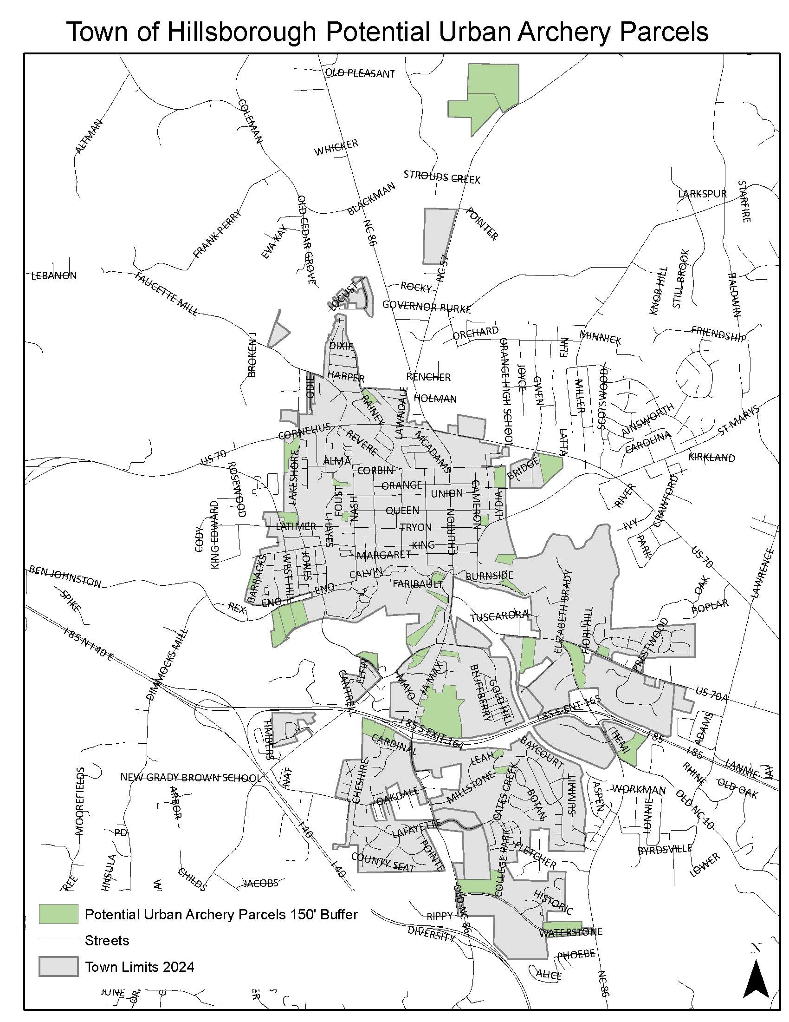
Eligible Properties
Staff has identified 48 potentially eligible properties that meet the following criteria:
Over 2 acres in size
Privately-owned (not public property or open to public recreation)
Not multifamily or commercial uses
At least 150 feet from structures

Slide 11
Other Concerns
Irregular town borders may create confusion over town regulations vs. County/NC Wildlife regulations
Staff/administrative oversight of program
Suitable parcels for hunting are not generally where the problematic deer populations are located
Deer are causing significant landscape material damage on both public and private property
Urban Archery program is generally ineffective at controlling/reducing deer population
Other nuisance animals not addressed – groundhogs, vultures, geese, etc.
Input has not been received from broader community

Slide 12
Additional Options to Consider
In addition to a potential Urban Archery program, the Board may also consider:
Work with NC Wildlife and/or consultant on comprehensive wildlife management plan
Additional education/outreach on dangers of feeding deer
Promotion and use of deer-resistant landscaping
Hiring of professional wildlife management contractor to harvest from public property in controlled program

Slide 13
Potential for Urban Archery Program in Hillsborough
Board of Commissioners
March 11, 2024

