Slide 1
Board of Commissioners Meeting
March 11, 2024 Molly Boyle, Planner II molly.boyle@hillsboroughnc.gov

Slide 2
Section 6.21.3 Design Standards – Public Streets
Original proposal: Allow ROW reductions for local streets when on-street parking removed (min. 48’; commercial project)
Concerns from JPH: 48’ too narrow (esp. for residential); other design elements impacted
Revised proposal:
Commercial/industrial locals and collectors only (no residential)
ROW can be reduced by no more than the width of omitted on-street parking
All other design elements must be met (e.g., travel lanes, bike lanes, C&G)
Planning Board: Recommended approval (7-1)

Slide 3
Section 6.21.3 Design Standards – Public Streets
Travel lane widths are not eligible for reduction. Requirements in the Street Manual must be met.
Hillsborough Street Manual
Prepared by TJCOG
Based on NCDOT’s complete street guidelines/Roadway Design Manual
AASHTO Green Book (7th edition) for urban/suburban streets
Green Book Recommended Travel Lane Widths
Typical travel lanes: 9’ - 12’
Urban/suburban locals: 9’ – 11’ (town = 10’)
Urban/suburban collectors: 10’ – 12’ (town = 11’)

Slide 4
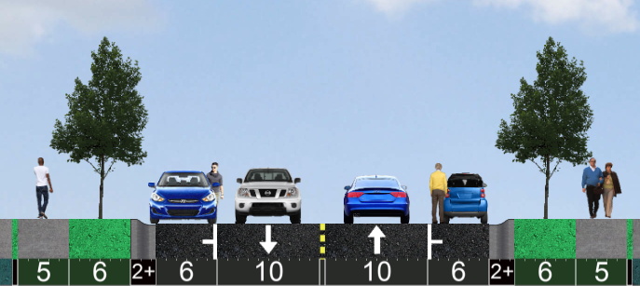
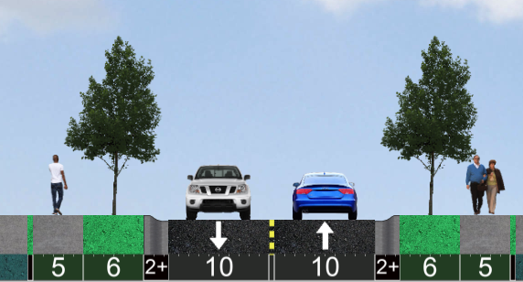
Commercial/Industrial Local (60’ ROW with parking)
Commercial/Industrial Local (48’ ROW without parking)
Right-of-Way: 60’
Sidewalk: 5’
Planting Strip: 6’
Travel Lane: 10’
On-street Parking: 8’ (6’ asphalt, 2’ curb & gutter)
Right-of-way: 48’
Sidewalk: 5’
Planting Strip: 6’
Travel Lane: 10’
On-street Parking: None (curb and gutter remains)

Slide 5
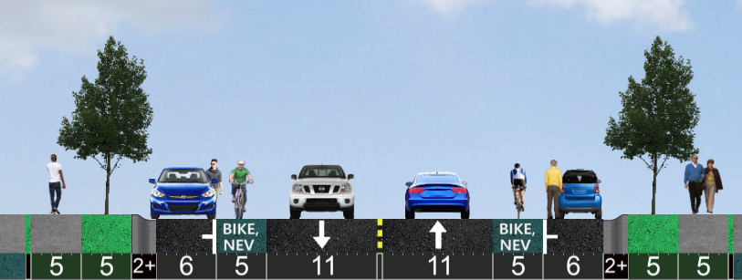
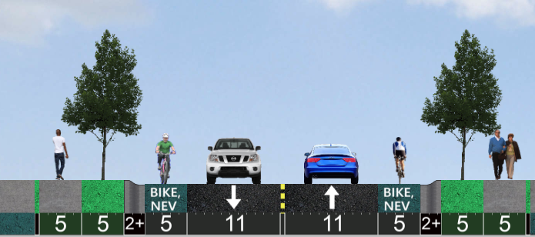
Commercial/Industrial Collector (70’ ROW with parking)
Commercial/Industrial Collector (58’ ROW without parking)
Right-of-Way: 70’
Sidewalk: 5’
Planting Strip: 5’
Travel Lane: 11’
On-street Parking: 8’ (6’ asphalt, 2’ curb & gutter)
Right-of-way: 58’
Sidewalk: 5’
Planting Strip: 5’
Travel Lane: 11’
On-street Parking: None (curb and gutter remains)

