Slide 1
FY25-27 Budgetary Planning Retreat
Framing: Finances, Issues and Approaches

Slide 2
Good News!
Audit and monthly postings up to date!
Strong savings*
* Artificially high due to COVID
Equipment - good shape and following replacement cycles
Employee Turnover Slowed, Positions Being Filled
Growth
Health Insurance

Slide 3
General Fund: Concerns/Watch Areas
Projected Deficits:
FY24 ‐ $1,133,221 (6.8%)
FY25 ‐ $1,548,339 (9.4%)
FY26 ‐ $1,745,767 (10.2%)
Sales Tax
Growth
Staffing, capital, maintenance, programs +
How to pay for implementing Comp. Sus. Plan
Affordable Housing:
How to pay for the
2-cent ramp-up?

Slide 4
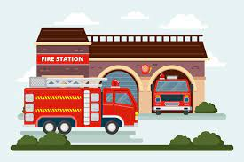
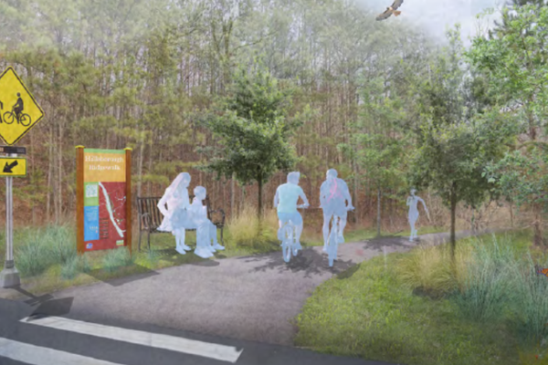
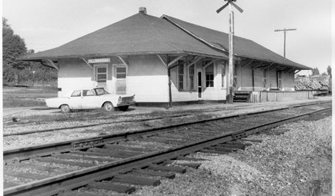
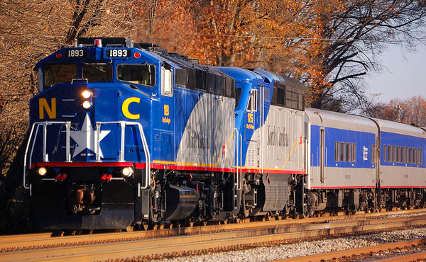
General Fund — Big Capital

Slide 5
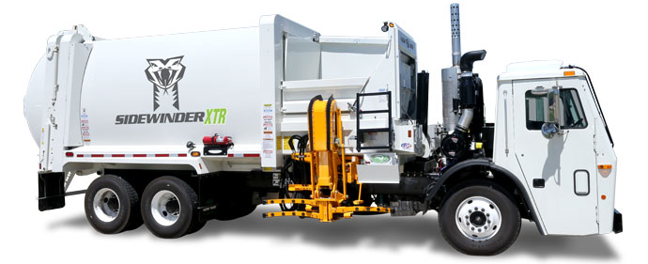
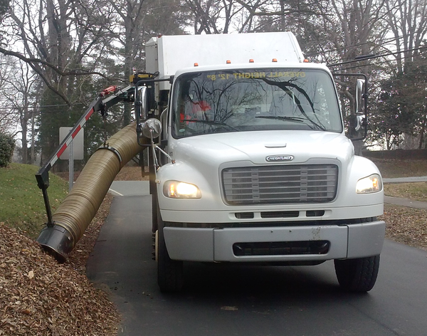
Years 1 and 2: Public Works Equip. Replacements — $1 million

Slide 6
Water and Sewer Fund: Concerns/Watch Areas
Projected Deficits:
FY24 ‐ $1,768,570 (12.3%)
FY25 ‐ $1,849,615 (13.0%)
FY26 ‐ $2,383,750 (15.4%)
Rates
#1 — Pipes and
Pump Stations
WWTP Capacity
System capacities and ability to serve areas.
Shrink service area!
Can’t plan if the target is moving!
Pressure from development!
What to delay?
Can’t do it all
Double Whammy:
Construction costs + interest rate escalation
Gap: Funding sustainability and climate initiatives

Slide 7
#1 Issue of the Year and Beyond Convergence: Water and Sewer Capacities, Land Use, Rate Affordability and Development
If, Where, and How Much to Grow?
Comp. Sus. Plan and
UDO Rewrite
Water
Sewer
Financial Planning What can we afford and when?
Paying for new development? Lack of capacity, “pinch points,” and upfront capital costs make serving some areas financially problematic

Slide 8
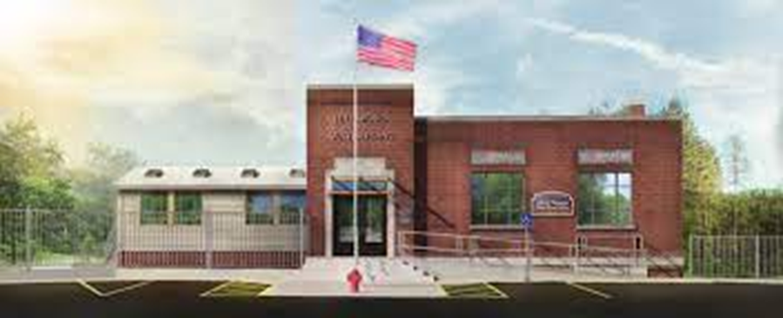
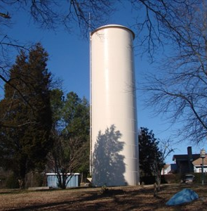
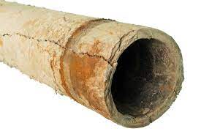
Water — Big Capital
Adron Thompson Reno/Expansion (FY25): $6.5M
Hassell St. Water Tank (FY25-27): $3.7M for Land, Design, Construction
OWASA Booster Pumps — Phases 1 and 2 (FY26): $3.6M — (BRIC and STAG Grants)
U.S. 70 Business Water Line (FY26-27): $3M

Slide 9
Sewer — Big Capital: $30 million in next 4 years?
River Pump Station: $8.2M — (70% BRIC Grant)
Elizabeth Brady Pump Station and Force Main Upgrade
(FY26-27): $4.6M
Train Station Pump Station: $50,000 – $725,000
Interceptors (FY26-28): $16.5M
Eno River, Churton St. to RPS: $5.0M
Exchange Club Drive: $1.3M
Eno River West, Churton to Occ.: $2.1M
Cates Creek Outfall $8.1M
“Game changer”: construction costs - estimates v. actual bids?
What to delay or eliminate if estimates increase?

Slide 10
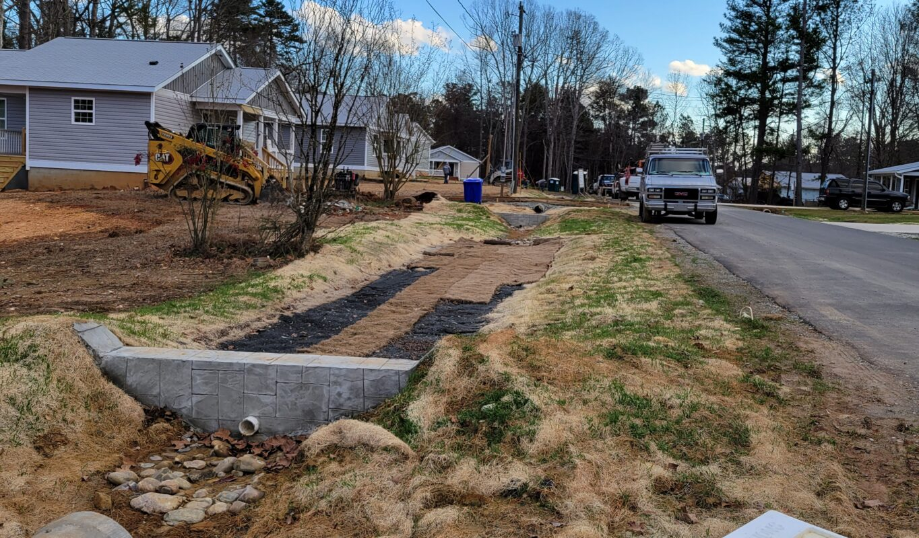
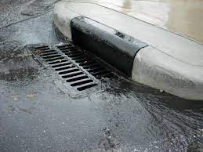
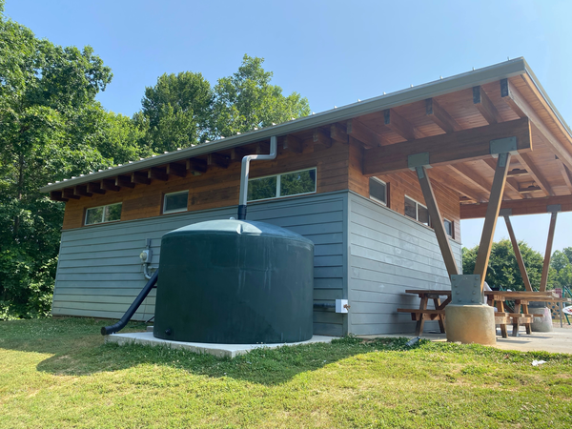
Stormwater
No fee increases for 8 years, since the utility was created in 2016
Fee increase delayed last year for further evaluation.
Staff currently reviewing fees (whether to propose an increase, changes to fee structures with a focus on lots with the largest impervious surface area).

Slide 11
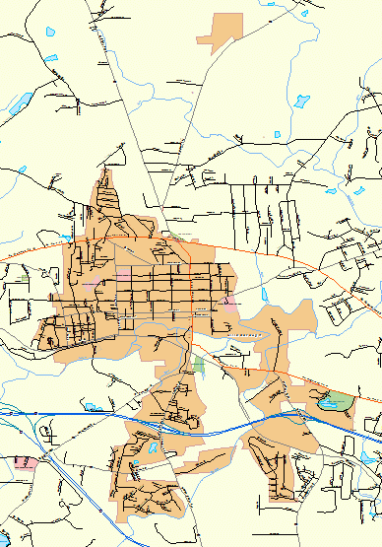
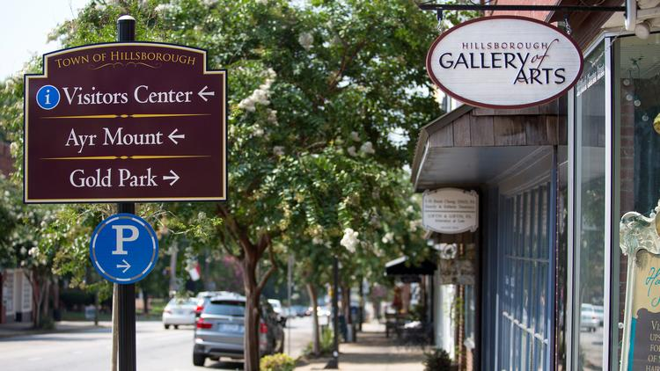
Operational Requests: All Funds

Slide 12
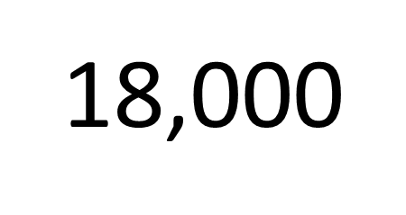
Top Challenge - Growth Pressures Local Govt: Service Industry and Asset Management “Crises of the day”: Preventing Progress on Top Priorities and Long-term Planning

Slide 13
Context: How much new growth to pay for 1 FTE?* *Last year’s Estimate
General Fund: 40 – 50 residential units
Water/Sewer Fund: 70 - 80 units
Stormwater Fund: 1,000 units
Doesn’t include vehicle, annual raises, and market adjustments
Always looking for alternatives to adding FTE’s that are more affordable and flexible (e.g., process redesign, delaying, temps, interns, fellows, PT, contractors, etc.)

Slide 14
Pop Quiz: How do we pay for all this?
Debt financings? Bundling? What about bonds?
Savings?
Grants?
System Development Fees?
Raise taxes or rates?
Funding ramp-ups and capital reserve funds?
Say “no,” delay, bridges, band-aids, limit scope creep?
Limit FTE’s?
Other?
What’s the most important tactic? Why?

Slide 15
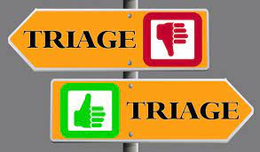
Combination of Answers
Paying for projects
v.
Staff capacity to manage!

Slide 16
Town Board Goals, Priorities, Preferences: Staff Focus

