Slide 1
Corbinton Alleys
Board of Commissioners
March 11, 2024
(Modified)

Slide 2
Introduction
Request from Corbinton residents to reconsider staff position on acceptance of alleys for public maintenance
Staff and residents have worked together for years to try to get developer to complete infrastructure
Residents have devoted a significant amount of time and energy over the years advocating for the developer to deliver a finished product
Residents have been immensely helpful to staff in identifying and tracking construction deficiencies
This is not a case of the town and residents being at odds; interests are aligned in trying to address subpar performance by the developer

Slide 3
Condensed Timeline
2003/2004 – Board denies rezoning and SUP, applicant appeals, town ordered to issue SUP
2004-2006 – litigation continues, SUP finally issued June 2006
2006/2007 – Construction drawings approved. Initial set indicated private alleys, final set changed to public
2016 – Plat recorded for development including public right-of-way for alleys. Includes statement that developer will maintain alleys until dedication is accepted by public authority
6/2020 – Initial punch list for streets/sidewalks/stormwater conveyance provided to developer
8/2020 – Final residence issued certificate of occupancy
1/2022 – Alleys deeded from developer to HOA
2/2022 – Email from staff to HOA – “The recorded plat for the community clearly indicates the alleys are dedicated to public use. The town has been operating under the assumption they would be dedicated once our standards are met.”
Summer 2022 – Developer widens turn radii of Alleys B/C, paves section of Alley E
11/2022 – Town Attorney sends final punch list to developer. References at least 4 earlier communications.
2/2023 –Board updated on lack of progress
2/2024 – Email from town staff to HOA - Developer no longer owns alleys, and alleys are not constructed to town standards, staff advises that they should remain under HOA ownership.

Slide 4
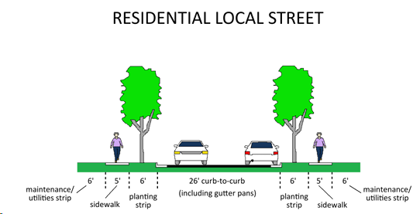
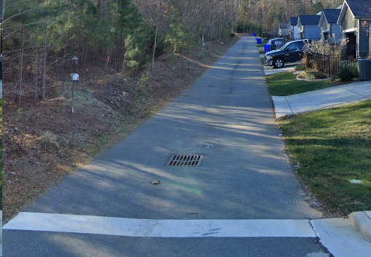
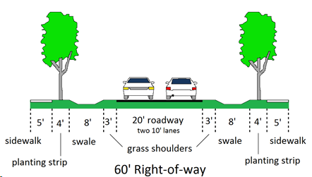
Comparison of Alleys to Street Standards
No sidewalk
No planting strip
No curb & gutter
No swale
14’ width
Center drain

Slide 5
Options for Consideration
Option | Pro | Con
1 – Town accepts alleys as-is, brings to standards at town expense | Ends discussions with developer, HOA no longer responsible for maintenance, streets will be improved, avoids additional costs to HOA | Against recent precedent, puts cost burden on town and other residents, may not be feasible under current standards*
2 – Town accepts alleys after HOA brings into compliance with standards | Ends discussions with developer, HOA no longer responsible for maintenance, streets will be improved, aligns with recent precedent, avoids additional cost to town | Puts cost burden on HOA and residents, may not be feasible under current standards*
3 – HOA maintains ownership and responsibility, town continues to provide service via Hold Harmless agreement | Ends discussions with developer, residents continue to receive services, consistent with another neighborhood in town | HOA and residents bear cost of maintenance and eventual replacement
4 – Town and/or HOA continue to pursue developer to bring alleys to standards | Neither town or HOA burdened with cost, puts responsibility on rightful party | Requires protracted negotiations or legal action, continues status quo for undetermined time, cost for attorneys, may not be successful

Slide 6
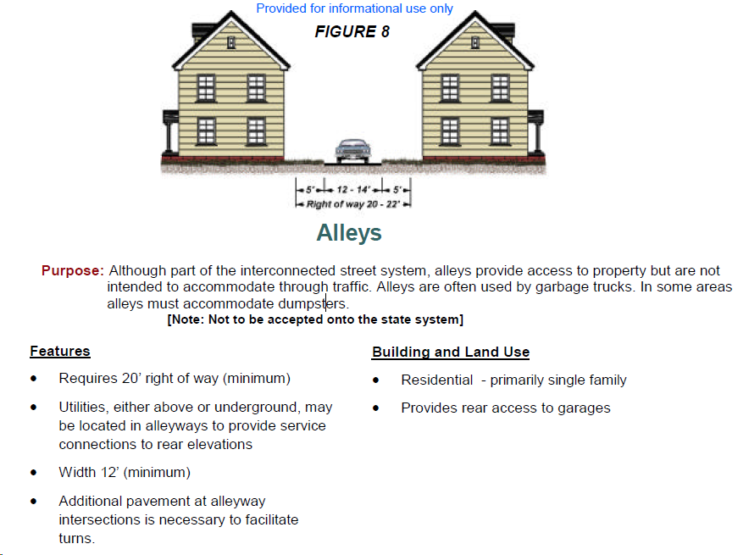
Option – NCDOT Traditional Neighborhood Design Guidelines

Slide 7
Corbinton Alleys
Board of Commissioners
March 11, 2024

